Slide 1



SHIELDING SYSTEM FOR OFFSCUM LABOURS USING IOT SENSOR
PROJECT REVIEW
TEAM MEMBERS
SNEHA R (927621BEC204)
VASUNTHRA P ( 927621BEC237)
SNEHA R (927621BEC203)
SHALINI S (927621BEC194) GUDIED BY
Dr.A.SRIDEVI (Assistant Professor/ECE)

Slide 2
OBJECTIVE
In India sewage cleanings are difficult and risky job for anyone.
To develop a device which would monitor the health of the sewage workers.
The device here will help the worker to inform the external unit as he needs help.
The detected values of the sensor will be updated in the application via IOT .

Slide 3
INTRODUCTION
Sewage labours die every year due to lack of facilities available while cleaning the sewage.
Manholes are not designed for someone to work in regularly.
Necessary to prevent the sewage workers from the poisoning of gases.
If the drainage system is not properly managed then pure water gets contaminated.

Slide 4
PROBLEM FORMULATION
Use of methane, carbon monoxide, and hydrogen sulfide sensors is not cost efficient rather using single toxic gas sensor.
There is no way for the sewage worker to get help from the external unit when he feels he is in danger

Slide 5
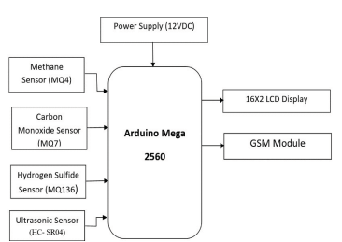
EXISTING SYSTEM
The methane, carbon monoxide, and hydrogen sulfide sensors provide alerts to the exterior unit using sensors of two way communication.
The main problems for the workers include falls, fire or explosion, oxygen depletion, gas poisoning, and fumes inside the sewer.

Slide 6
FINDINGS IN EXISTING SYSTEM
Need replacement of sensors of the already existing equipment.
Need to give a way to the worker to express as he is in danger.
Hence, bringing down the overall cost with better performance.

Slide 7
PROPOSED SYSTEM
The main component of this system is Arduino controller.
Various sensors are used for the proposed system.
Toxic gas sensor
Panic Button
Temperature sensor
Ultrasonic sensor
Information will be send through IOT technology.
Gas sensor level is high, Vibrator will be ON
The received sensor details display on LCD at receiver with help of IOT.

Slide 8
PROPOSED SYSTEM
With the use of an ultrasonic sensor, the water level is indicated to determine whether the drainage is full.
The increase in the temperature in drainage is detected by the temperature sensor.
Panic Button has been introduced in this system in order to get help from the external unit when he feels as he is in danger
The values of the sensor will be displayed on the LCD board for the external unit

Slide 9
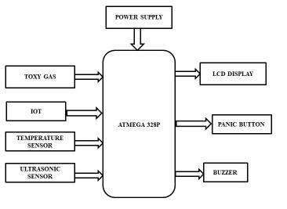
METHODOLOGY

Slide 10
METHODOLOGY EXPLANATION
POWER SUPPLY:
Power supply in this system will provide power via transformers to all the sensors
TOXIC GAS:
The toxic gas sensor present here will deduct the toxic/harmful gases inside the sewage
IOT:
The messages from the sensor will be sent to the website via IOT.

Slide 11
METHODOLOGY EXPLANATION
TEMPERATURE SENSOR:
The temperature sensor in Arduino converts the surrounding temperature to voltage. It further converts the voltage to Celcius, Celcius to Fahrenheit, and prints the Fahrenheit temperature on the LCD screen.
ULTRASONIC SENSOR:
Active ultrasonic sensors generate high-frequency sound waves and evaluate the echo which is received back by the sensor, measuring the time interval between sending the signal and receiving the echo to determine the distance to an object.

Slide 12
METHODOLOGY EXPLANATION
PANIC BUTTON:
The alarm can be used to request emergency assistance from local security, police, or emergency services.
BUZZER:
An Arduino buzzer is also called a piezo buzzer. It is basically a tiny speaker that you can connect directly to an Arduino.

Slide 13
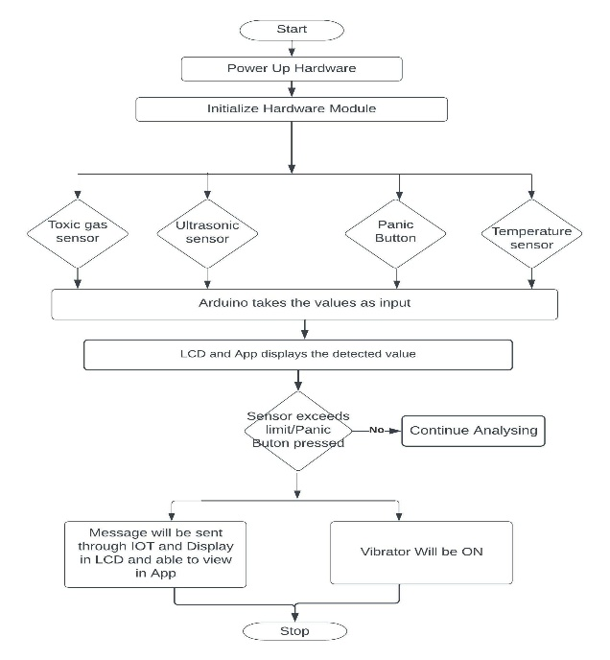
SUPPORTING DIAGRAM

Slide 14
SOFTWARE REQUIREMENT SPECIFICATION
Programming language - Embedded C
Compiler - ARDUINO IDE

Slide 15
HARDWARE REQUIREMENT SPECIFICATION
ARDUINO UNO
POWER SUPPLY
TOXIC GAS SENSOR
ULTRASONIC SENSOR
LCD DISPLAY
BUZZER/VIBRATOR
TEMPRATURE SENSOR
PANIC BUTTON

Slide 16
APPLICATION:
Domestic gas leakage detector.
Industrial Combustible gas detector.
MERITS:
There is no need for separate gas sensors.
Cost Efficient.
DEMERITS:
High internet speed needed.

Slide 17
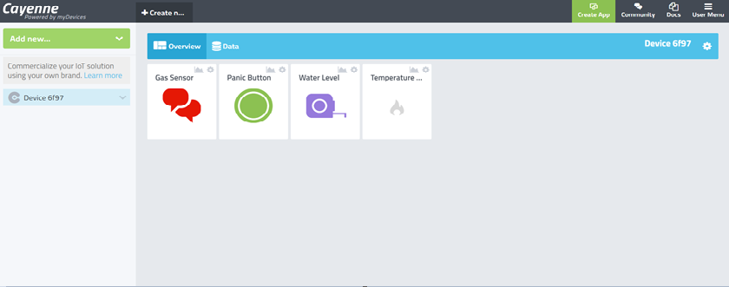
RESULT

Slide 18
CONCLUSION AND FUTURE WORK
The device finds major application in household sewage systems, municipal manholes, sewage, sewer, deep well, gutters and drains etc.,
In countries like India, where sewage is mostly cleaned by humans, which makes this device is useful around India.
The device present now is not handy for workers, so in future we can develop it as handy and can be fixed in cap or belt for the worker

Slide 19
THANK YOU

Slide 20
ANY QUERIES ?

